Slide 1
Currents

Slide 2
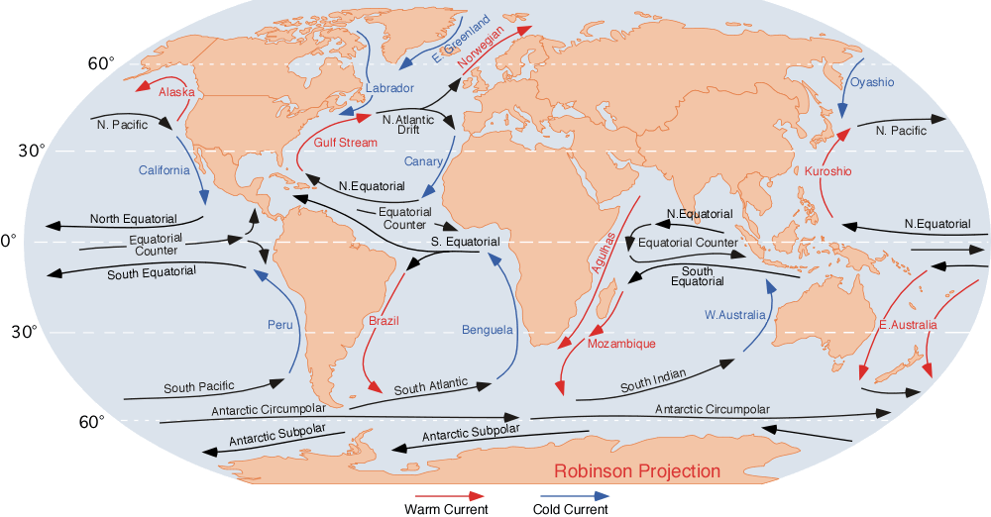
Ocean currents
Small streams in the ocean
http://www.physicalgeography.net/fundamentals/images/oceancurrents.gif

Slide 3
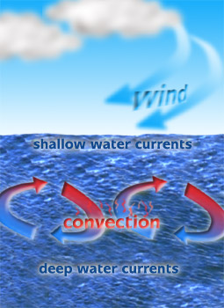
Surface current
When the top of the ocean water is moved by the wind and the turning of the earth.
http://1.bp.blogspot.com/_iO4rWKndoMw/Sx7EfjLab1I/AAAAAAAAAB0/zJ_5wnoQcDM/s400/Convection+currents+oceans

Slide 4
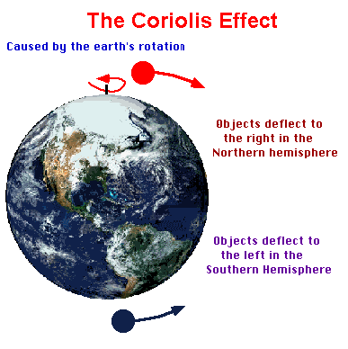
When the earth turns, it makes the currents turn sideways.

Slide 5
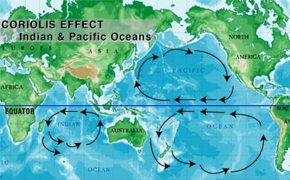
Continental Deflection
When currents hit the land, they change direction.

Slide 6
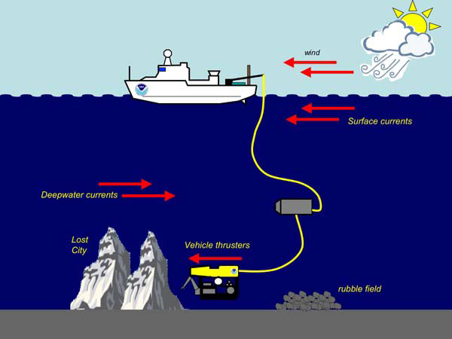
Deep currents
Movement of water deep in the ocean. Deep currents are not affected by wind, but by how heavy the water is due to salt content and temperature.

