Slide 1
Underground Water

Slide 2
Groundwater
What is Groundwater????
The water that has seeped into the soil and rock.
The underground area is broken down into 4 areas…
1) Zone of Aeration
2) Water Table
3) Zone of Saturation
4) Impermeable Rock layer

Slide 3
Start from the bottom Impermeable Rock layer
Impermeable rock - Rock that will not allow water to flow through it.
What does this mean????
When the water reaches this point it cannot seep into the ground further.
If the water cannot move down into the earth any further, what must happen?
It begins to build upward underneath the earth’s surface.
This moves us into the next zone……..

Slide 4
Zone of Saturation
Zone of Saturation – This is the zone where water collects underneath the earth’s surface.
Where is the water stored in this zone? Is it flowing like a river underground? Where is the water stored ?
The water is stored in the spaces between the rock particles. This is called POROSITY.

Slide 5
Porosity
Porosity – The percentage of space between individual rocks under the surface of the earth.
If a rock layer is filled up with particles of different sizes, then it will have a low percentage of open space. This mean that it will have what kind of porosity?
LOW!!!!!!!!!!
If a rock layer is filled up with evenly sized particles, then it will have a high percentage of open space. This mean that it will have what kind of porosity?
HIGH!!!!!!!!

Slide 6
Zone of Aeration
Zone of Aeration – This is the upper zone that allows water to pass easily through it.
This zone is very permeable!!!!
Permeability – A rock’s ability to allow water to flow through it.

Slide 7
Water Table
Water Table – This is the boundary between the Zone of Aeration and the Zone of Saturation!!!
This means that where the zone of aeration and the zone of saturation meet, the water table is present!!!!

Slide 8
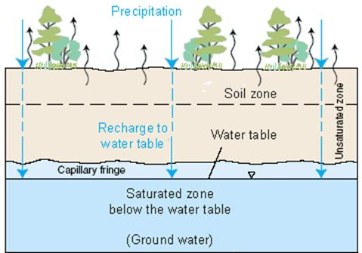
A look at the Layers!!
Zone of Aeration
Zone of Saturation

Slide 9
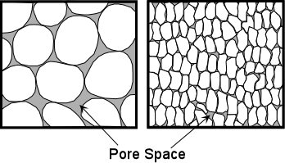
A look a Porosity
A
B
Which has a larger porosity?

Slide 10
Aquifers
Aquifer – A rock layer that stores ground water and allows the flow of ground water.
These usually form in permeable materials.
They depend on the water cycle to maintain the constant flow of water. The spot where water re-enters the aquifer is called the RECHARGE ZONE!

Slide 11
Recharge Zone
Recharge Zone – the ground surface where water enters an aquifer.
The size of this zone depends on how much permeable rock is at the surface.
Construction on top of recharge zones also limit the amount of water that can enter an aquifer.

Slide 12
Springs and Wells
Springs form when the water table reaches the earth’s surface, water will flow out of the ground.
In areas where the water table is higher than the earth’s surface, lakes will form
There is another type of spring, what is it called??

Slide 13
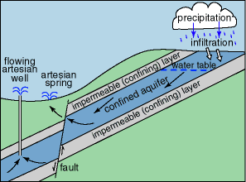
Artesian Spring
Artesian Spring – a spring whose water flows from a crack in the cap rock of the aquifer.

Slide 14
Wells
What is a well?
A well is a man-made hole that extends deeper than the water table.
What are wells used for?
Wells are used to pull water to the surface from the groundwater source.
What happens if the well is not deep enough or there are too many wells close together?
They dry up!!!

Slide 15
A Closer Look At Wells!!!

Slide 16
Underground Erosion & Deposition
As we all know, rivers and streams erode the surface of the earth, but can groundwater cause erosion underneath the surface of the earth????
YES!!!!
Underground water can dissolve limestone (a rock underneath the earth). When this happens, caves form.

Slide 17
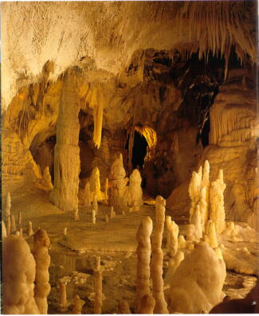
Caves
Caves are formed from erosion, but they show signs of deposition.
The deposition in caves comes in three different forms
1) Stalactites – Icicle-shaped features that form on the ceilings of caves.
2) Stalagmites – Icicle-shaped features that form on the floors of caves.
3)Column – A stalactite and stalagmite that have joined together.
Stalactites
Column
Stalagmites

Slide 18
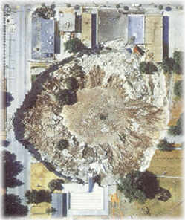
Sinkholes
When water erodes the ground underneath the Earth’s surface forming a cave. The top of the cave begins to erode and the roof of the cave falls in.
When this happens, a SINKHOLE forms
Sinkhole – A circular depression formed after the roof of a cave collapses.

Slide 19
End of Section Vocabulary
Zone of Saturation – This is the zone where water collects underneath the earth’s surface.
Porosity – The percentage of space between individual rocks under the surface of the earth.
Zone of Aeration – This is the upper zone that allows water to pass easily through it.
Permeability – A rock’s ability to allow water to flow through it.
Water Table – This is the boundary between the Zone of Aeration and the Zone of Saturation!!!
Aquifer – A rock layer that stores ground water and allows the flow of ground water.

Slide 20
End of Section Vocabulary Contd.
Recharge Zone – the ground surface where water enters an aquifer.
Well - A man-made hole that extends deeper than water table.
Artesian Spring – a spring whose water flows from a crack in the cap rock of the aquifer.
Stalactites – Icicle-shaped features that form on the ceilings of caves.
Stalagmites – Icicle-shaped features that form on the floors of caves.

Slide 21
End of lesson Review Questions
1)Which of the following describes an aquifer’s ability to allow the flow of water?
A. Porosity
B. Permeability
C. Geology
D. Recharge Zone
2)What is the Water Table?

Slide 22
Questions Contd.
3) Explain how particles affect the porosity of an aquifer?
4) Name two features that are formed by underground deposition.
5)What feature does underground erosion create?
6)Explain the difference between a spring and a well.

