Slide 1
Theory of Plate Tectonics/ Continental Drift
Movement of tectonic plates that move over the surface of the Earth.
https://www.youtube.com/watch?v=HrKTuCDierM
http://www.youtube.com/watch?v=ELd3ebldSTs
https://www.youtube.com/watch?v=uMuJxd2Gpxo

Slide 2
Evidence from ocean floor
Sea Floor Spreading:
  Mid ocean ridge: sea floor splits, magma flows out and builds mounds and forms new oceanic crust.
  Ocean Trenches: oceanic crust sinks in the asthenosphere (where magma circulates)
  Old crust is being destroyed as new crust is forming.

Slide 3
Convection Current
Energy transfer by movement of a material.
http://www.youtube.com/watch?v=ryrXAGY1dmE

Slide 4
3 ways of moving
Divergent: moving away from each other
Convergent: Moving towards each other
oceanic/continental subduction: ocean sinks under a continent – volcanoes form.
Continental/continental – collision (mountains or uplift)
Oceanic/oceanic subduction: 1 plate goes under the other plate: islands form.
Transform – Moving sideways with each other.
http://www.youtube.com/watch?v=p4LFu91Xrw0

Slide 5
Species Change Over Time

Slide 6
Warm up NB page 93
Using the geologic time scale wheel completed last class answer the following questions.
1) In what era did coal swamps appear?
2) In what era did coral reefs flourish?
3) In what era did flowering plants emerge?
4) In what era did humans appear?

Slide 7
Why is the Geologic Time Scale important?
What does the Geologic Time Scale tell us?
What did you notice about the evolution of life on Earth?

Slide 8
The Theory of Evolution
Section 1

Slide 9
Evolution
Extinctions-
  occur following a sudden drastic change in the environment
If organisms don’t adapt quickly enough to survive, they die
The extinction of a species can affect an entire ecosystem
  Species that relied on the extinct species for food may die
  Species that once competed for food with the extinct species may thrive
Extinction is a natural part of evolution
Scientist s estimate that about 99.9% of all species that ever lived on Earth have become extinct
On average a species will survive on Earth 2 to 10 million years

Slide 10
Natural Events for Extinctions
temperature
rainfall
volcanic eruption
earthquakes
flooding or drought
shifting land masses or seas
a change in food supply
a new predator or disease

Slide 11
Mass Extinctions
Permian Extinction
250 million years ago species living in the ocean and on land became extinct because land masses moved together which changed the climate of Earth
Cretaceous Extinction
65 million years ago dinosaurs disappeared on Earth
Asteroid Theory- at the rock layer between the Cretaceous and Tertiary periods evidence of an asteroid can be found

Slide 12
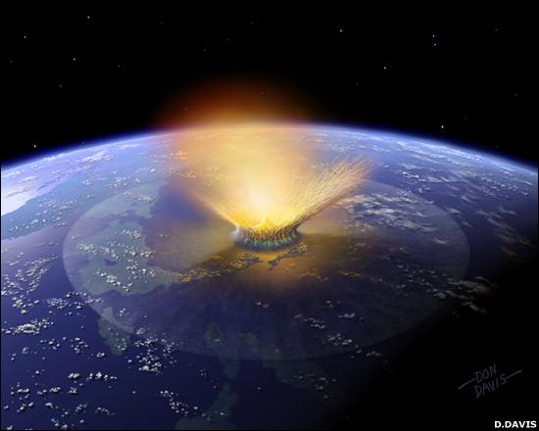
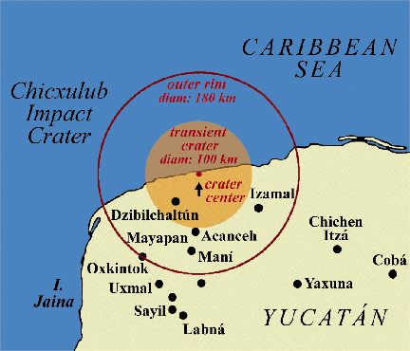
Chicxulub Crater
May have caused the Cretaceous extinction.

Slide 13
Human Threats for extinction
Threat | Description | Remedy
Habitat | Habitat changes quickly | Reduce human encroachment –land management
Invaders | Non - native species introduced to new locations | Reduce introduction and reintroduce native species
Pollution | Contaminated land, air, water | Improve waste management
Overgrazing Forest burning | Habitat changed or destroyed | Land use management

Slide 14
Overharvesting | Species taken for food, energy, medicine | Species management reduce demand
Climate Change | Ozone depletion, greenhouse effect | Reduce usage
Poaching, overhunting, overfishing | Rapid death of too many animals of a species | Reduce demand, laws

Slide 15
Isn’t Evolution just a Theory
http://www.pbs.org/wgbh/evolution/educators/teachstuds/svideos.html
Answer the following questions from the video.
What is a theory?
What is an inference?
What was Charles Darwin’s theory?

Slide 16
Natural Selection
Section 2

Slide 17
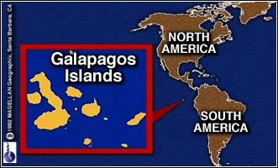
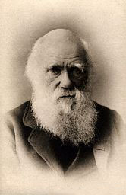
Charles Darwin (1809-1882)
Sailed around the world 1831-1836

Slide 18
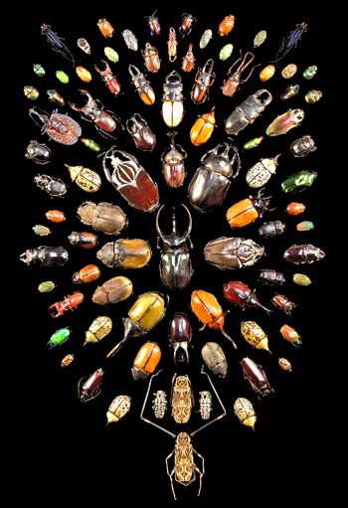
What did Darwin’s Travels reveal
The diversity of living species was far greater than anyone had previously known!!
These observations led him to develop the theory of evolution!!

Slide 19
Charles Darwin- based in part his evolutionary theory on observations of finch species on the Galapagos islands.
Different species of finch had developed different beak sizes for the types of food that was available on the different islands
Suggested that the different species of finch had evolved from the original species in response to different environmental conditions

Slide 20
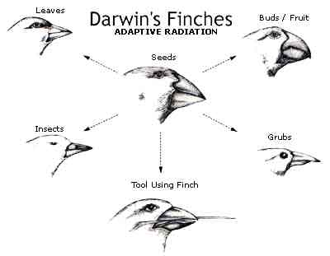
How did tortoises and birds differ among the islands of the Galapagos?
Each island had its own type of tortoises and birds that were clearly different from other islands

Slide 21
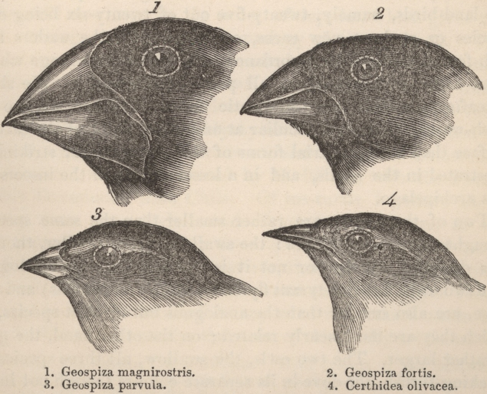
http://www.classzone.com/books/ml_science_nc8/page_build.cfm?id=none&u=2#

Slide 22
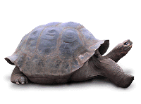
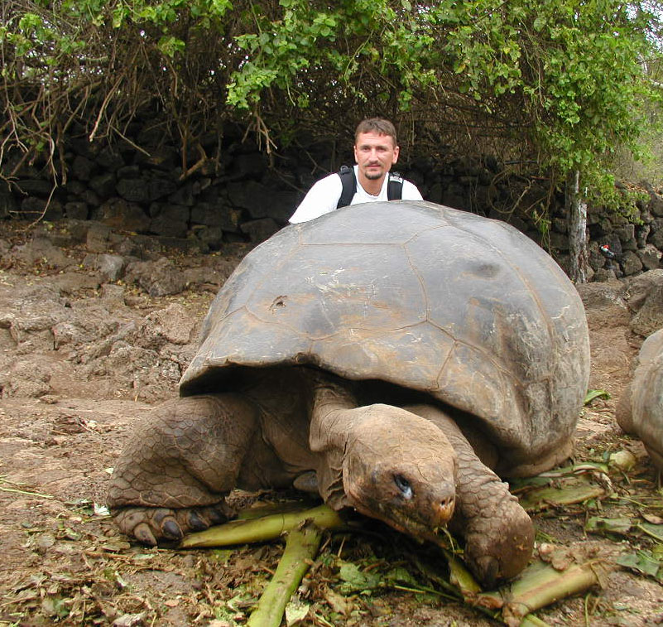
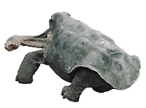
Galapagos Turtles
Short Neck
Long Neck

Slide 23
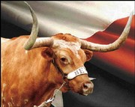
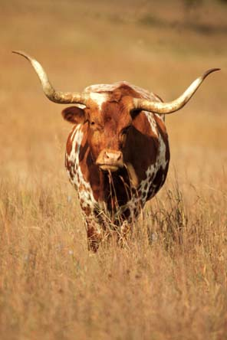
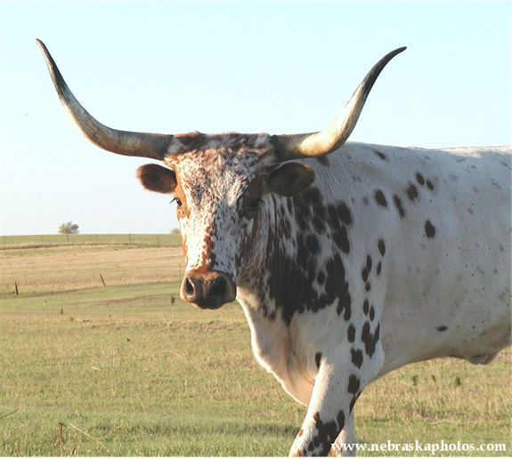
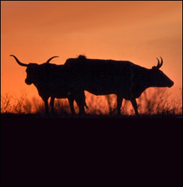
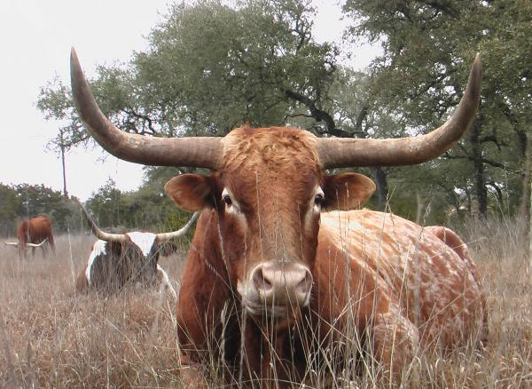
Artificial Selection
nature provides variation, humans select variations that are useful.
Example - a farmer breeds only his best livestock

Slide 24
Natural Selection and Species Fitness
Overtime, natural selection results in changes in the inherited characteristics of a population.
These changes increase a species fitness (survival rate)

Slide 25
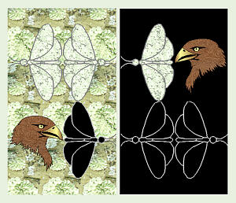
Natural Selection
The traits that help an organism survive in a particular environment are “selected” in natural selection
http://www.techapps.net/interactives/pepperMoths.swf

Slide 26
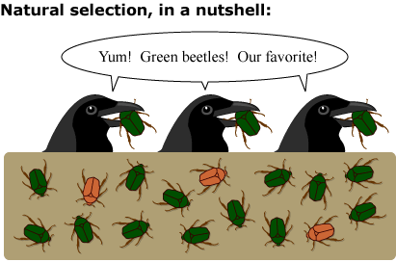

Slide 27
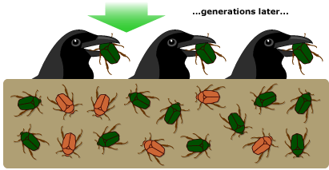

Slide 28
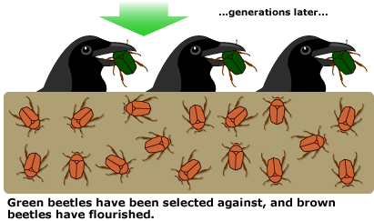

Slide 34
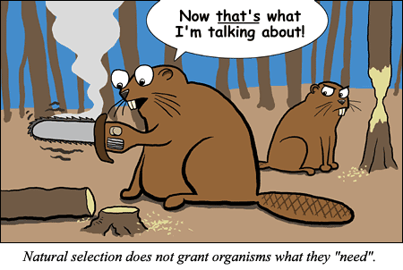

Slide 35
Natural Selection

Slide 36
Summary of Darwin’s Theory
1. Organisms differ; variation is inherited
2. Organisms produce more offspring than survive
3. Organisms compete for resources
4. Organisms with advantages survive to pass those advantages to their children
5. Species alive today are descended with modifications from common ancestors

Slide 37
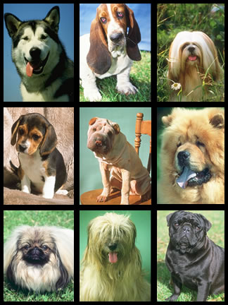
Theory of Natural Selection
Darwin knew from personal experience that dog breeders can produce new species over time by selective breeding techniques. Breeding dogs with desired traits produces a new breed of dog. This process is called artificial selection.
He thought this process might
be naturally occurring in nature
and termed it natural selection.

Slide 38
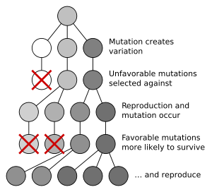
Key Principles of Natural Selection
Overproduction- most organisms produce more offspring than can survive
Variation- visual differences among individuals result from differences in genetic material this process of changing base pairs in the DNA is called a mutation

Slide 39
Warm up: NB page 54
What was the central idea of the notes yesterday?
What evidence from the notes helped you determine this?

Slide 40
Adaptation- a trait that improves an organism’s chance for survival and reproduction.
Selection- the individuals that have the adaptation increase in numbers and are able to adapt to the environment over the individuals who do not have the adaptation

Slide 41
How does evolution really work?
http://www.pbs.org/wgbh/evolution/educators/teachstuds/svideos.html

Slide 42
Evidence of Evolution

Slide 43
Evidence of Evolution
Fossil Record
Geographic Distribution of Living Species
Homologous Body structures
Similarities in Embryology

Slide 44
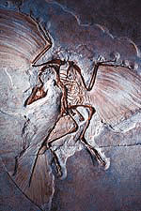
Evidence of Evolution
Fossil Record provides evidence that living things have evolved
Fossils show the history of life on earth and how different groups of organisms have changed over time

Slide 45
Evidence of Evolution
Geographic Distribution of Living Species
  Similar animals in different locations were the product of different lines of descent

Slide 46
Evidence of Evolution
Homologous Body Structures
  Structures that have different mature forms but develop from the same embryonic tissues
    e.g. wing of bat, human arm, whale flipper, leg of cat

Slide 47
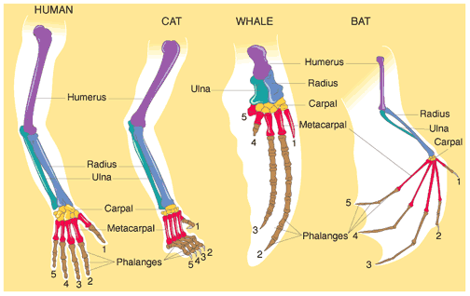
Homologous Body Structures

Slide 48
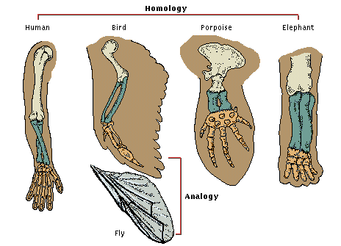
Analogous Structures look different but essentially perform the same function for each organism.

Slide 49
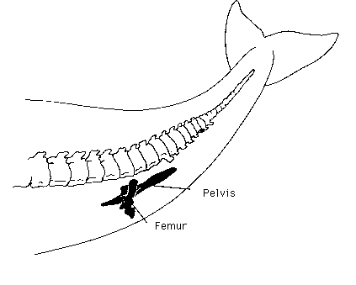
vestigial organs- are physical structures that were fully developed and functional in an earlier group of organisms but are reduced and unused in later species.

Slide 50
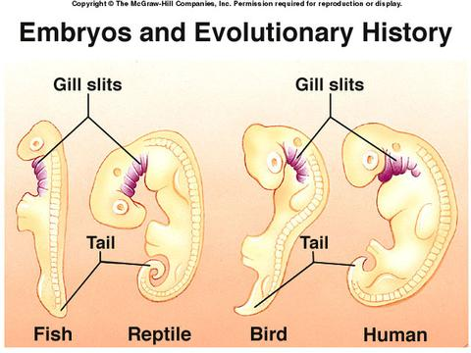
Evidence of Evolution
Similarities in Embryology
  In their early stages of development, chickens, turtles and rats look similar, providing evidence that they shared a common ancestry.

Slide 51
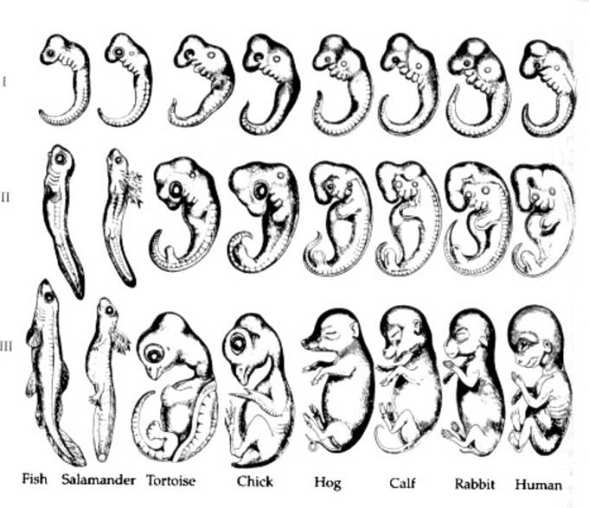
Embryological development

Slide 52
More Evidence that supports the Theory of Evolution is Vestigial Organs
  traces of homologous organs in other species
  Organ that serves no useful function
    Example: Appendix

Slide 53
Embryonic Development
http://multimedia.mcb.harvard.edu/
Why does evolution matter today?
http://www.pbs.org/wgbh/evolution/educators/teachstuds/svideos.html

Slide 54
EVOLUTION & SPECIATION

Slide 55
NEW VOCABULARY
GENE POOL – COMMON GROUP OF ALL GENES PRESENT IN A POPULATION

Slide 56
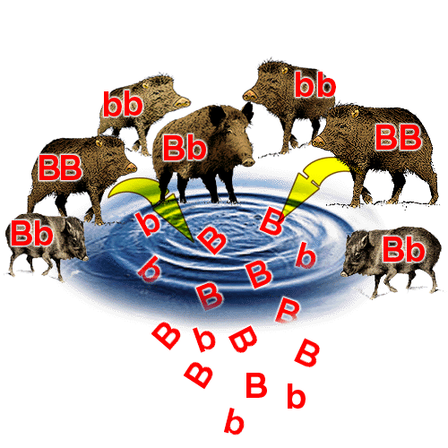
Gene Pool
Combined genetic info. of all members
Allele frequency is # of times alleles occur

Slide 57
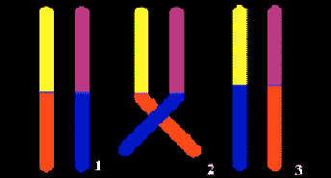
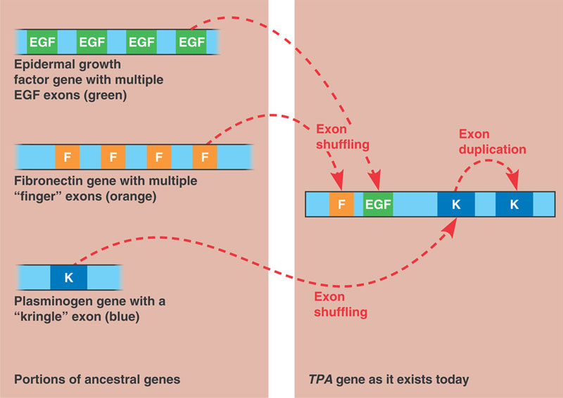
Variation in Populations
2 processes can
lead to this:
Mutations -
change in DNA
sequence
Gene Shuffling –
from sexual
reproduction

Slide 58
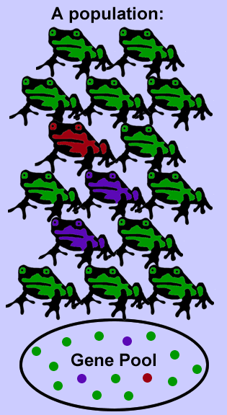
Evolution of Populations
Occurs when there is a change in relative frequency of alleles

Slide 59
SPECIATION
THE FORMATION OF NEW SPECIES
AS NEW SPECIES EVOVLVE, POPULATIONS BECOME REPRODUCTIVELY ISOLATED
REPRODUCTIVE ISOLATION – MEMBERS OF 2 POPULATIONS CANNOT INTERBREED & PRODUCE FERTILE OFFSPRING.

Slide 60
SPECIATION IN DARWIN’S FINCHES
SPECIATION THE GALAPAGOS FINCHES OCCURRED BY:
- FOUNDING OF A NEW POPULATION,
- GEOGRAPHIC ISOLATION which led to -- REPRODUCTIVE ISOLATION and
CHANGES IN THE NEW POPULATION’S GENE POOL due to COMPETITION.

Slide 61
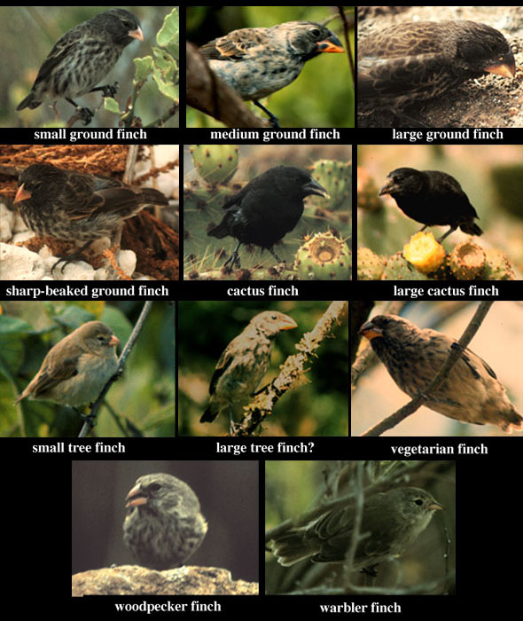

Slide 62
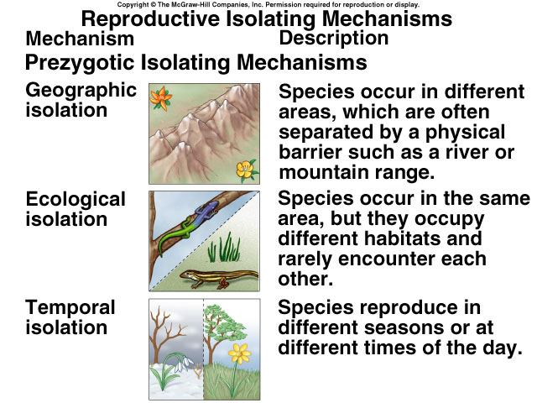
Table 23.1a

